Slide 1


MORELIA AUTOMATIZATION RB LOGO STITCHING PROCESS

Slide 2
Project Chapter
Key Feature
Automatization Stitching Process with Computer Stitching Machine
Goals of Benefit
Reduce Manpower
Increase productivity index output: PPH (prs/person/hour)
Reduce Cost
Implement on mass production
For June-2013 Production:
a. MRL CLUB MD (12KP38415, 12KP97601)
b. MRL CLUB Jr. 24 (12KP38715)

Slide 3
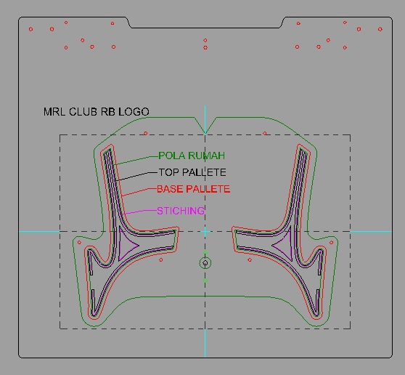
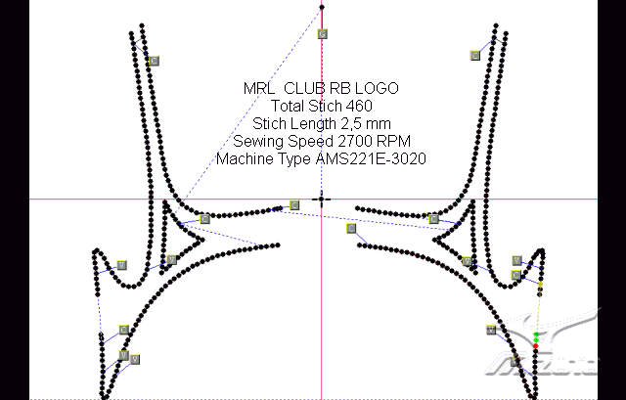
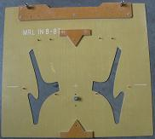
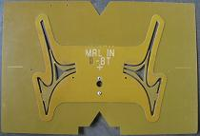
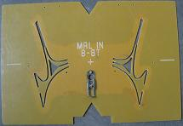
Pallet Design & Construction of RB Logo
1. Pallet Design of RB logo Lateral & Medial
2. RB Logo base Pallet: To placed and lock RB Logo material during stitching process. | 3. RB Logo Top Pallet: To gripped lock RB Logo material during stitching process.

Slide 4
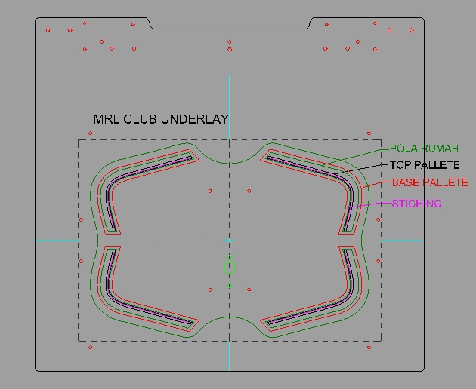
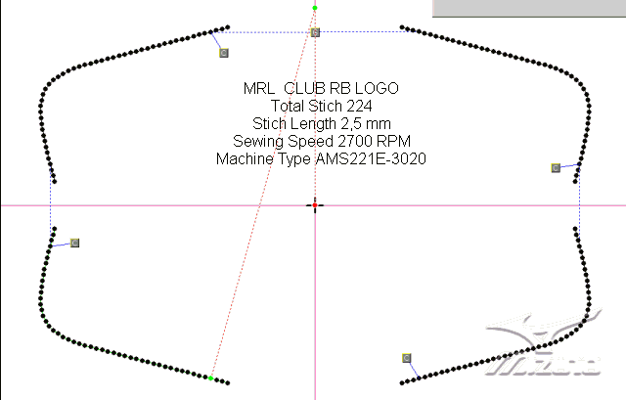
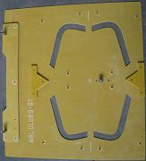
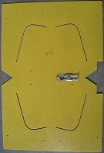
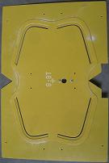
Pallet Design & Construction of RB Logo
1. Pallet Design of RB logo U’ly (Lateral & Medial)
2. Base Pallet RB Logo U’ly : To placed and lock RB Logo material during stitching process. | 3. Top Pallet RB Logo U’ly: To gripped lock RB Logo U’ly material during stitching process.

Slide 5
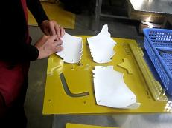
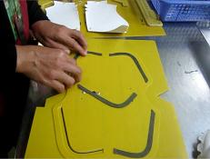
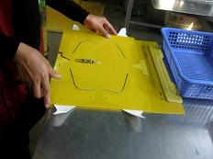
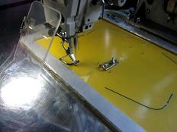
Auto-Stitching Process for RB Logo U’ly
1. Attached Qtr Component to Base PIN Palette
2. Insert RB Logo U’ly to the TOP Palette
3. Locking RB Logo U’ly Top Palette to Qtr Base PIN Palette
4. Auto-Stitch RB Logo U’ly

Slide 6
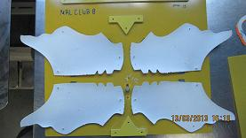
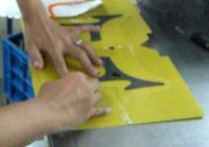
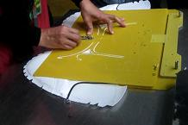
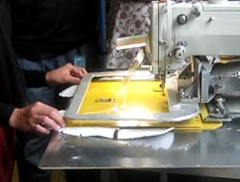
Auto-Stitching Process for RB Logo
1. Attached Qtr Component to Base PIN Palette
2. Insert RB Logo to the TOP Palette
3. Locking RB Logo Top Palette to Qtr Base PIN Palette
4. Auto-Stitch RB Logo

Slide 7
Comparison Process of
Conventional Stitch and Auto-Stitch
NO | Description | Current-Stitch | Auto-Stitch | Remark
1 | Total Labor (Sewing) | 9 | 7 | 2
2 | Productivity Index (PPH) *1 | 11.11 | 14.285 | 3.18
3 | Total Cycle Time | 274.29 | 235.33 | 39
4 | Cost Process
 | a. Direct Labor *2 | 0.194 | 0.151
 | b. Overhead (Electricity) | 0.0021 | 0.0015
 | c. Sundries (Cement)
 | d. Preparation Cost (Palette) *2 | 0 | $0.0025
5 | Total Cost Reduction | 0.1965 | 0.1552
 | Cost Reducing/prs | $0.0413
Remark:
*Standard out put production 100prs/hour
*1=> 100 pr / 9 Mp and 100 pr / 7 MP
*2=> 9 x $2.16/100 and 7 X $2.16/100
*3=> Pallete : $123.28 / 50K = $0.0025

Slide 8
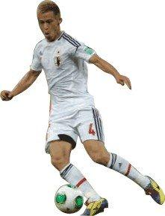
PRIDE OF MIZUNO GO TO BRAZIL ON WORLD CUP 2014
ARIGATOU GOZAIMASU

